Slide 1
Field Test Administration

Slide 2
Scheduling Testing Time: Things to Note
Tests and PTs will be presented in up to three separate tests.
For 95%, 3 tests total: 2 condensed tests (ELA and math) and 1 PT
For 5%, 2 tests total: 1 test (ELA OR Math) and 1 PT in same content area
ELA PTs have 2 parts; math PTs have 1 part
Reminder: Overall testing time will be the same, regardless of content assignment (approximately 3.5–4 hours).

Slide 3
Scheduling Testing Time: Things to Note
Scheduling is a collaborative effort.
Each school is assigned a 6-week window.
Recommended: Test first, PT second.
Classroom activity should be completed within 3 days prior to starting the PT.
ELA PTs have 2 parts and can be completed over 2 days.
Math PTs have 1 part and can be completed in 1 day.
Recommended: PT should not be administered on the same day as test.

Slide 4
Scheduling Considerations for Special Populations
Students taking CAPA will appear in TIDE but should not be tested.
English Learners in US schools for 12 months or less should not be given any ELA items.
SCs must ensure that TAs know which students are not to take the FT.
Schedule activities for students not taking exam (or that finish early).

Slide 5
Establishing Appropriate Testing Conditions
Displayed information (on bulletin boards, chalkboards, or dry-erase boards, etc.) that might be used by students to help answer questions must be removed or covered, including:
Rubrics, vocabulary charts, student work, posters, graphs, charts, etc.
Make appropriate seating arrangements prior to test administration.
Establish procedures to maintain a quiet testing environment throughout the test session.
Remember that some students will finish more quickly than others.

Slide 6
Establishing Appropriate Testing Conditions (cont.)
Cell phones or other electronic devices are not allowed to be used during testing (i.e., turned off and put away).
Place a “TESTING—DO NOT DISTURB” sign on the door.
Post an “Unauthorized Electronic Devices May Not Be Used at Any Time During the Testing Session” sign so that it is clearly visible to all students.
May also be helpful to post signs in halls and entrances rerouting hallway traffic.

Slide 7
General Rules During the Field Test
Students must answer all test items on a page before moving on to the next page.
Students may not return to a test segment once it has been completed and submitted.
Students must answer all test items before the test can be submitted.
Students may not return to a test once it has been completed and submitted.
There is a difference between “segment” and “session.”
Expiration and pause rules vary between PT and non-PT.

Slide 8
Test Administrator Interface
TAs need to use the interface to administer a test session.
The Test Administrator User Guide will be available on the California Smarter Balanced portal under Field Test > Resources and Documentation.
This document will contain complete instructions on how to complete tasks in the Test Delivery System.
Reminder: The easiest way to reach the California Smarter Balanced Portal is by visiting http://californiatac.org and selecting the portal button.

Slide 9
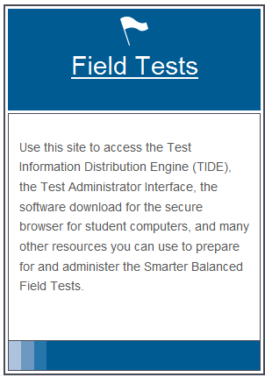
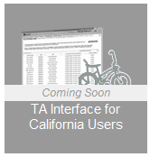
Accessing the
Test Administrator Interface
On the California Smarter Balanced Portal, select [Field Tests] on the left-hand side of the page.
The TA Interface button will be available to select.

Slide 10
Test Administrator Home Page
After you log in, you will see the home page of the TA Interface.
Figure 1. Before Starting a Test Session
Figure 2. After Starting a Test Session

Slide 11
Starting a Test
Using the TA Interface (not TIDE), TAs must start a test session before students can log in to a test.
A test can be selected by selecting the checkbox next to the test’s name.

Slide 12
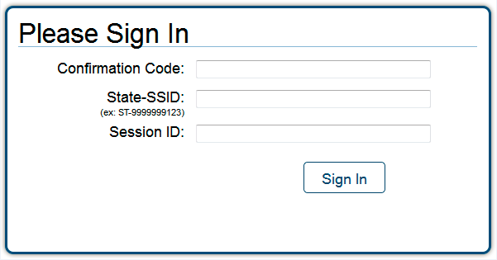
Student Login
To log in to the FT, each student will need:
Confirmation Code: Student’s legal first name as spelled in CALPADS
State-SSID: State abbreviation (CA) followed by a hyphen and the student’s Statewide Student Identifier
Session ID
Note: TAs must follow the “DFA SAY” script exactly each time a test is administered. Refer to the DFA section of the Test Administration Manual.

Slide 13
Distributing Student Login Information
TAs need to provide students with the Test Session ID, SSID, and confirmation code (CALPADS student first name) for login.
District Office will provide stickers with Student’s First name, State SSID *secondary schools will provide district with teacher name for printing (English?)
TAs may write the Test Session ID on the board or where students can see it.
Make sure students know the Test Session ID must be entered exactly as it is written, without extra spaces or characters.
NOTE: Student personal information is secure and must be collected at the end of a test session and destroyed at the end of testing.

Slide 14
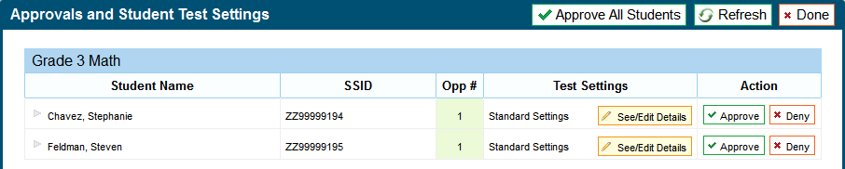
Approving Students for Testing
TAs can either select [Approve] for each individual student (recommended) or select [Approve All Students].
Reminder: If any student’s test settings are incorrect, do NOT approve that student.
To refresh the list of students awaiting approval at any time, select the [Refresh] button at the top of the pop-up window.

Slide 15
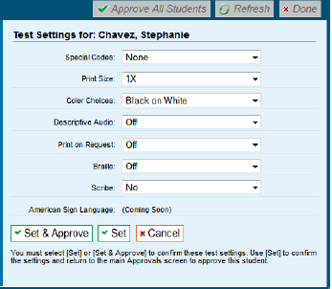
Test Settings and Accommodations
Confirm or select settings.
Select [Set] to confirm the current test settings and return to the list of students awaiting approval. You will still have to approve the student for testing.
Select [Set & Approve] to establish the updated settings and approve the student for testing.
Select [Cancel] if you want to return to the Approvals and Student Test Settings screen.

Slide 16
Monitoring Student Progress
The “Students in Your Test Session” table displays students who have logged in and been approved for testing.

Slide 17
Pausing Tests
Through the TA Interface, TAs may:
Stop an entire session; or
Pause individual student tests.
Users should exit or log out of the Test Administrator Interface only after stopping the test session.
If there is a technical issue (i.e. power outage or network failure), students will be logged out and the test will automatically be paused.
Regardless of when or how users log out or navigate away from the Test Administrator Interface, student data will NOT be lost.
Note: If a test is paused for any reason or length of time, the student must log in again to resume testing. Highlighted text and item notes will not be preserved.

Slide 18
Pause Rules During the Field Test: Non–Performance Task
During the field test, if testing is paused for more than 20 minutes, the student is:
Presented with the test page containing the test item he or she was last working on (if page contains at least 1 unanswered item) OR
Presented with the next test page (if all items on the previous test page were answered);
NOT permitted to review or change any test items on previous test pages.

Slide 19
Pause Rules During the Field Test: Performance Task
There is no pause rule for the performance task.
Even if a test is paused for 20 minutes or more, the student can return to the current section and continue.
ELA PTs are divided into 2 parts. After a student completes Part 1, he or she cannot return to it.

Slide 20
Test Timeout Due to Inactivity
As a security measure, students are automatically logged out of the test after 20 minutes of inactivity.
Activity means:
Selecting an answer
Using a navigation option in the test (i.e. selecting [Next] or [Back], using the Past/Marked Questions drop-down list)
NOTE: Moving the mouse or selecting an empty space on the screen is NOT considered activity.

Slide 21
Test Timeout Due to Inactivity (cont.)
Before the system logs out, a warning message will be displayed.
If a student does NOT select [Ok] within 30 seconds, the student will be logged out.
Selecting [Ok] will restart the 20 minute inactivity timer.

Slide 22
Stopping Tests: Entire Session
To stop the session (and pause tests for all students in the session):
Select the [Stop Session] button in the upper-left corner of the screen. An “Important!” box will appear, requesting verification to end the session and log students out.
Select [OK] to continue or [Cancel] to keep the test session open.

Slide 23
Pausing Tests: Individual Students
TAs may pause an individual student’s test in the Students in Your Test Session table.
This will not affect other students’ tests.

Slide 24
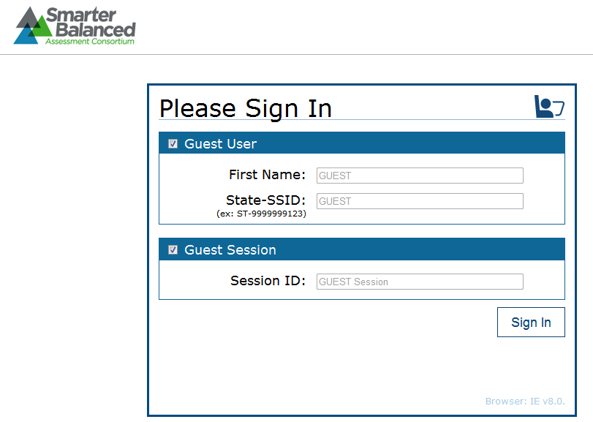
Student View of Testing
When the secure browser is launched, it opens to this page.

Slide 25
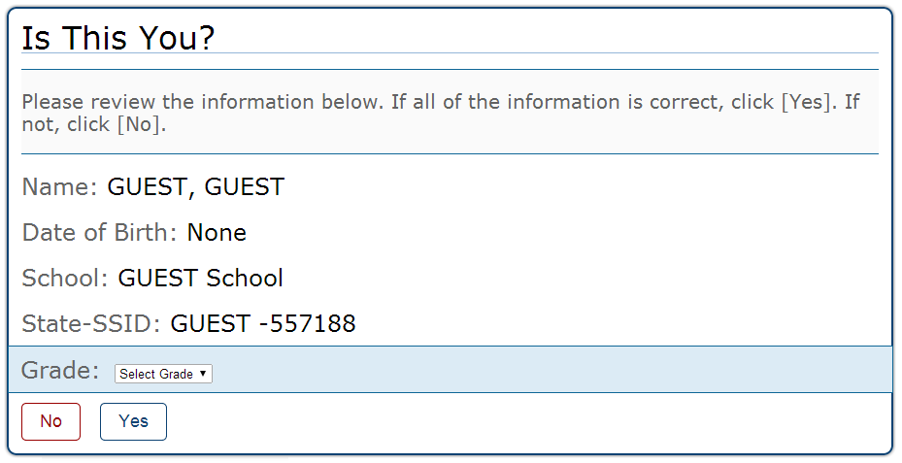
Student View of Testing:
Verifying Information

Slide 26
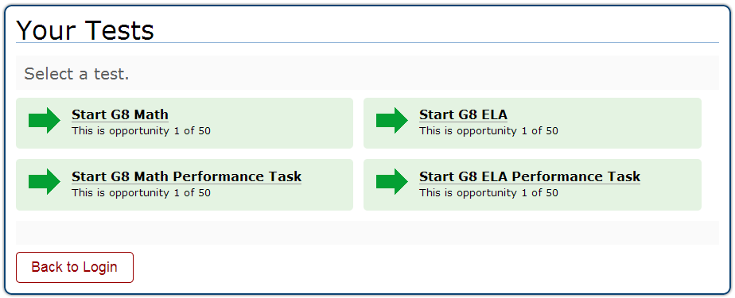
Student View of Testing:
Test Selection

Slide 27
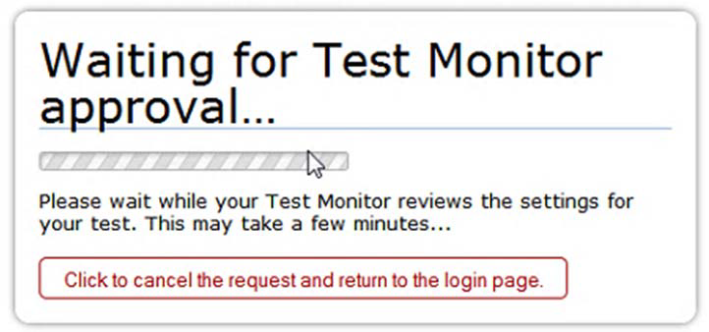
Student View of Testing:
Test Administrator Approval
The student will see the display above while waiting for the Test Administrator to approve the request for entry into the session.

Slide 28
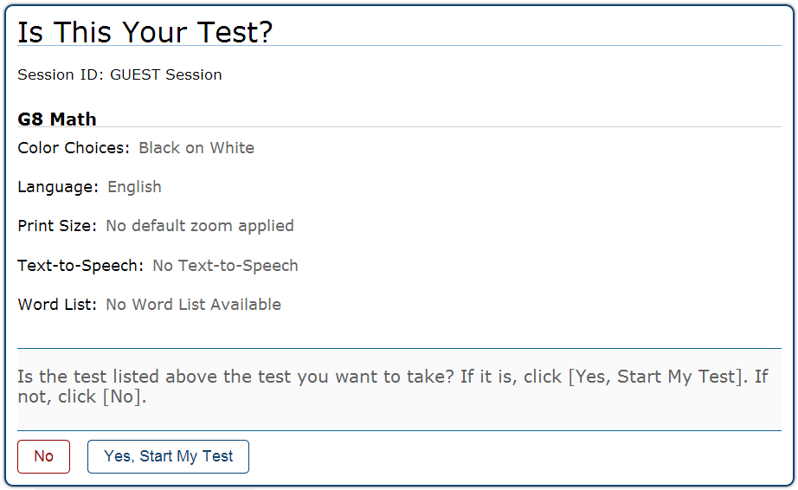
Student View of Testing: Is This Your Test?

Slide 29
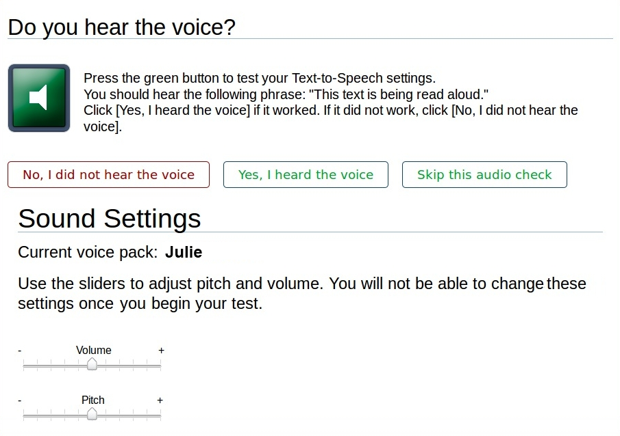
Student View of Testing:
Sound Check

Slide 30
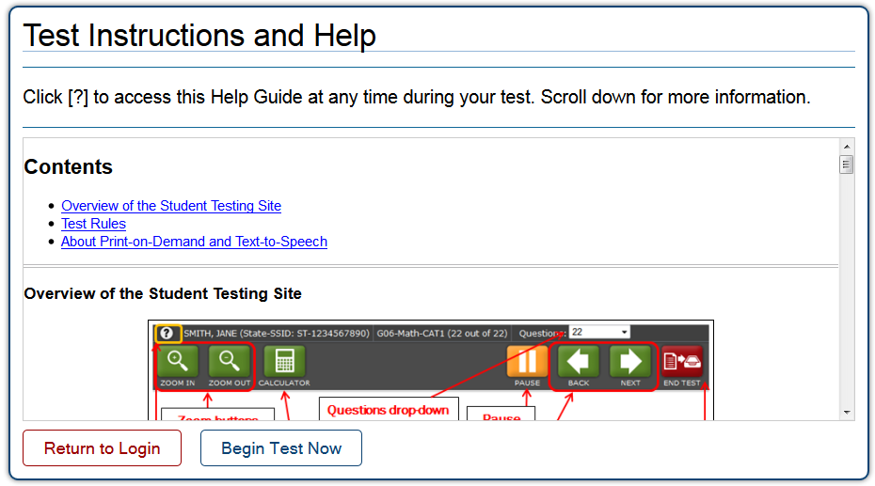
Student View of Testing:
Test Instructions

Slide 31
Universal Tools
All students have the ability to:
Highlight text in passages and test questions
Zoom in and out of test pages (affects all item content)
Mark specific items for review
Strikethrough (cross out answer options)
Use the Notepad or Calculator (depending on the test)
Use the [Expand] button to display a reading passage or a science simulation

Slide 32
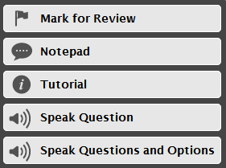
Context Menus
Context Menu for Questions
Context Menu for
Answer Options

Slide 33
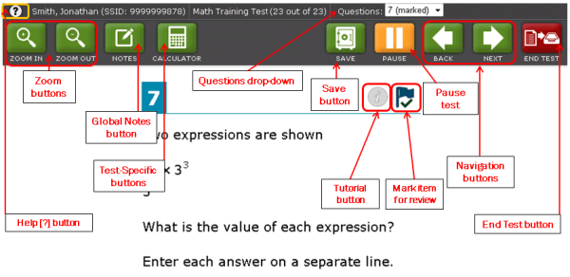
Proceeding Through the Test
To answer multiple-choice items, students must select the desired answer option or select the circle with A, B, C, or D.
To answer machine-scored constructed-response items, students need to carefully follow the instructions given for each question.

Slide 34
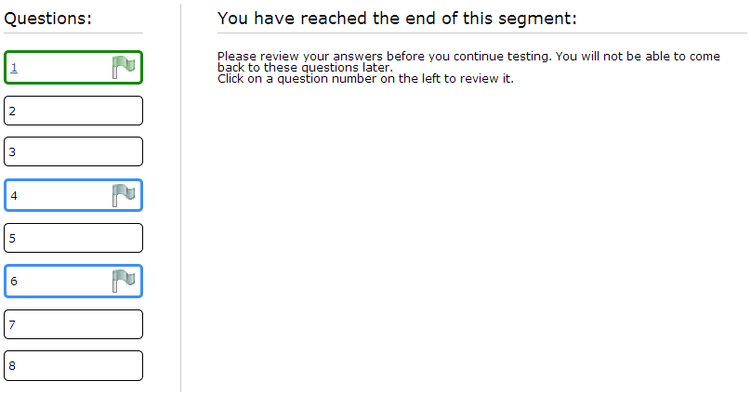
Reviewing Items

Slide 35
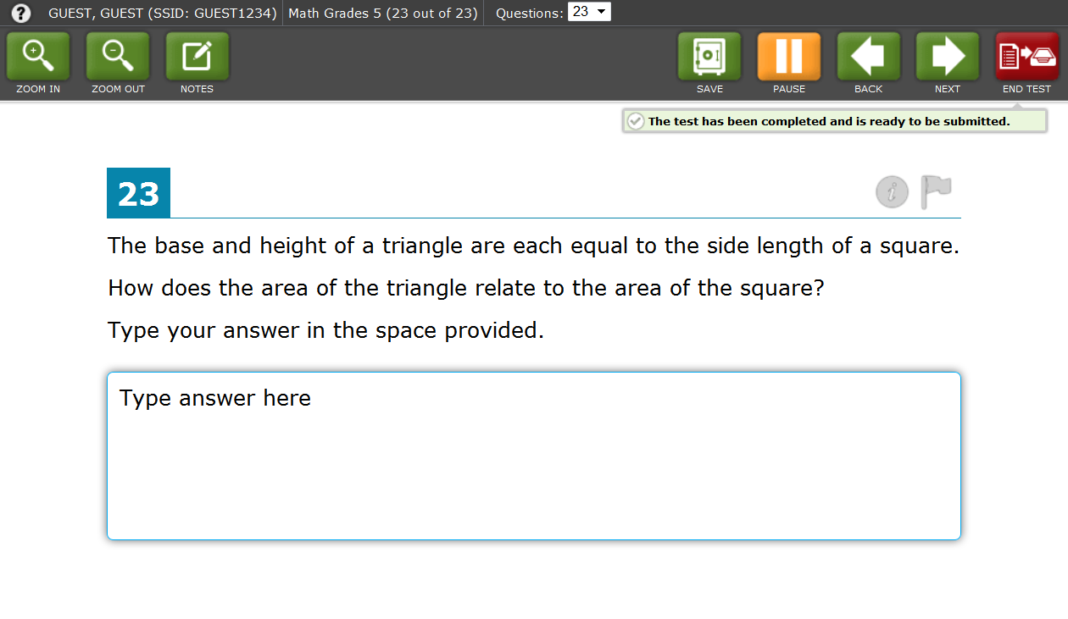
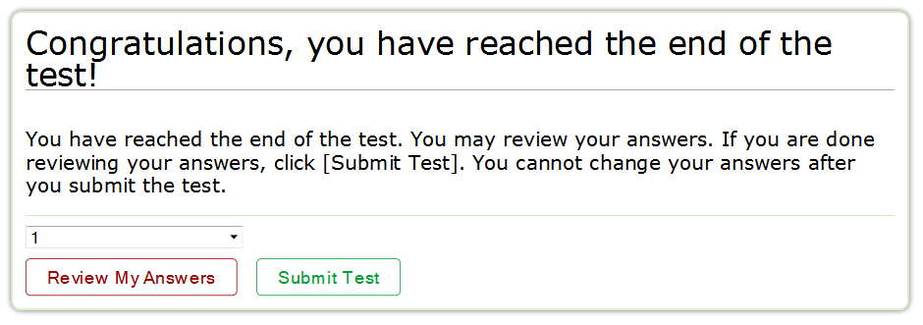
Ending the Test

Slide 36
Test Expiration
Rule: A student’s field test remains active until the student completes and submits the test OR when field test window closes. For the PT test, expiration comes after 10 calendar days. Note: System limits are superseded by the assigned 6-week testing window, and do not extend beyond the official FT end date, June 6.
Students are recommended to complete all FT components within 5 days of starting testing.

Slide 37
Classroom Activity Administration Guidelines
Classroom Activity Purpose: To provide students with important context, concepts, and key terms prior to taking the PT.
All students will have a classroom activity before they complete a PT in the assigned content area.
May be administered in a classroom or any other appropriate space.
May take place on a separate day from the PT.
Recommended: No more than a 3-day lapse between the classroom activity and the PT administration.
TA may need a chalkboard or dry-erase board.

Slide 38
Classroom Activity Administration Guidelines (cont.)
Computers, projectors, and other technology are allowed but not required for the classroom activity.
Involves the participation of all students in an instructional task.
PT will be completed by individual students in the computer-based test delivery system.
Students may take notes during the classroom activity, but the notes must be collected before proceeding to the PT.

Slide 39
Classroom Activity Administration Guidelines (cont.)
Designed to fit into a 30-minute window.
Will vary due to complexity of topic and individual student needs.
The SC should download the assigned classroom activity and provide to TAs at least 1–2 days prior.
After receiving the activity from the SC, the TA or classroom teacher should administer the classroom activity.
Provide the appropriate accommodations for students who normally use them during instruction.

Slide 40
Classroom Activity and Performance Task Administration
(SCs)
Step 1: Identify the classroom activities for your school.
Assigned by grade for each individual school.
Assignments will be posted on the portal.
Locate your state and then use the menus within the file to filter for your school.
Beside the name of the school will be a listing of the classroom activities assigned to each grade/content area.

Slide 41
Classroom Activity and Performance Task Administration
(SCs)
Step 2: Download the classroom activity.
Materials are posted in alphabetical order.
(TAs)
Step 3: Review the teacher directions for the classroom activity carefully.

Slide 42
Classroom Activity and Performance Task Administration
(TAs)
Step 4: Complete the classroom activity.
SCs should ensure that the TA has presented the classroom activity prior to PT administration.
Classroom activities include directions associated with that specific classroom activity.
Note: The classroom activity does not require computers.

Slide 43
Classroom Activity and Performance Task Administration
(TAs)
Step 5: Administer the make-up classroom activity.
For students who are absent on the day of the classroom activity, it is recommended that a make-up session be scheduled.

Slide 44
Classroom Activity and Performance Task Administration
Step 6. Administer the performance task.
The students must work independently
The PT is administered online
ELA PT: 2 parts (Part 1 and Part 2)
Recommended: Each part administered on separate days.
Part 1: Students will read sources and answer three research questions.
Part 2 (full write): Students will provide a written response using those sources.
Mathematics PT: 1 part
The mathematics PT should be administered in 1 session.

Slide 45
Test Security

Slide 46
New Test Security Forms for the 2013–14 School Year
The STAR Test Security Agreements submitted earlier this school year are no longer valid.
LTT and SCs must sign the new test security agreement and retain at the LEA.
TAs must sign the new test security affidavit and retain at the LEA.

Slide 48
Test Security
There are 3 different types of test security incidents:
Impropriety
Irregularity
Breach

Slide 49
Test Impropriety
Unusual circumstance that has a low impact on the testing individual or group of students
Low risk of affecting student performance, test security, or test validity
Correctable and containable at local level
Must be reported to LEA CAASPP Coordinator or Test Site Coordinator
Example: Students talking during testing

Slide 50
Test Irregularity
Unusual circumstance that impacts the testing individual or group of students
May affect student performance, test security, or test validity
Correctable and containable at the local level
Submitted in the online system for resolution of the Appeal for testing impact
Must be reported to LEA CAASPP Coordinator or Test Site Coordinator within 24 hours
Examples: Student cheating or providing answers to another; student accessing or using electronic equipment (e.g., cellphone)

Slide 51
Test Breach
Event that threatens test validity (e.g., release of secure materials)
External implications for the Consortium
A breach incident must be reported within 24 hours
Examples:
Administrator or coordinator modifying student responses or record at any time
Administrator allowing students to take home test items, passage, prompts, or scratch paper

Slide 52
Questions

Slide 53
Resources and Support
The California Technical Assistance Center is there to support YOU!
Available Monday – Friday from 7 a.m.– 5 p.m.
E-mail: caltac@ets.org
Phone: 800-955-2954
Web site: http://californiatac.org

