Slide 1
Student View of Testing

Slide 2
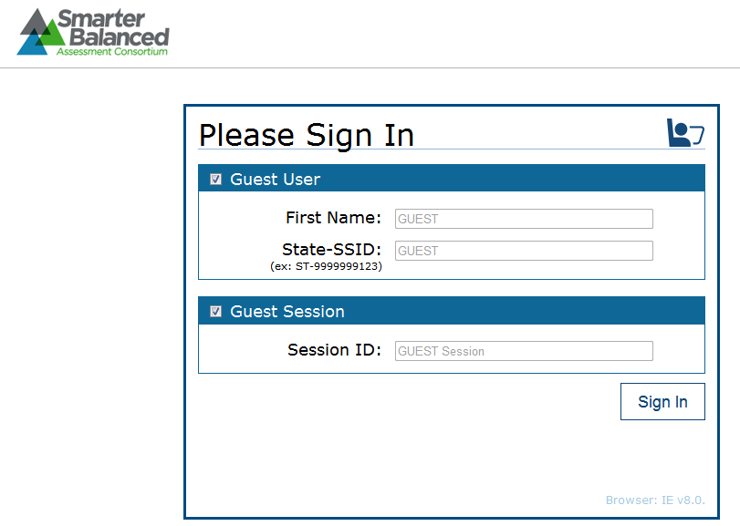
Student View of Testing
When the secure browser is launched, it opens to this page.

Slide 3
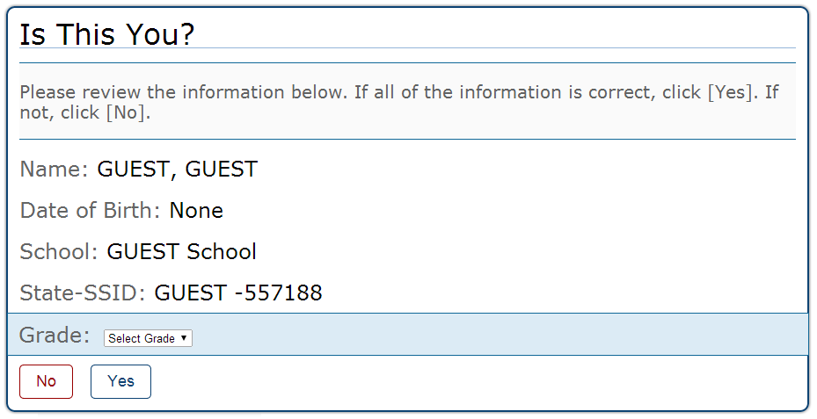
Student View of Testing:
Verifying Information

Slide 4
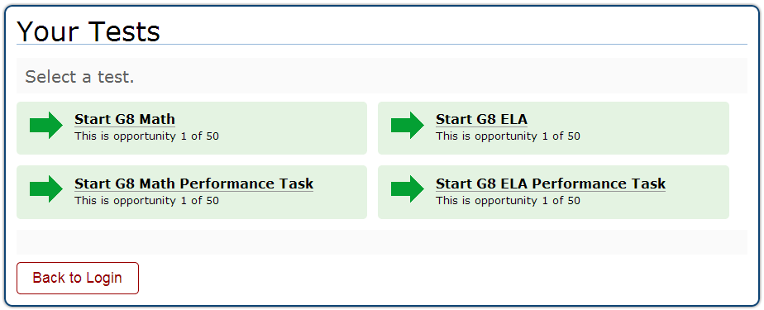
Student View of Testing:
Test Selection

Slide 5
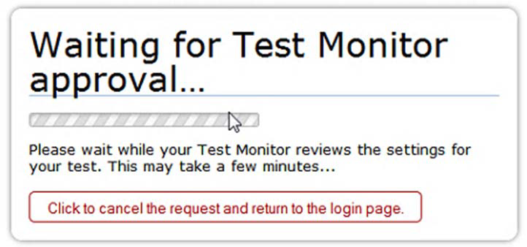
Student View of Testing:
Test Administrator Approval
The student will see the display above while waiting for the Test Administrator to approve the request for entry into the session.

Slide 6
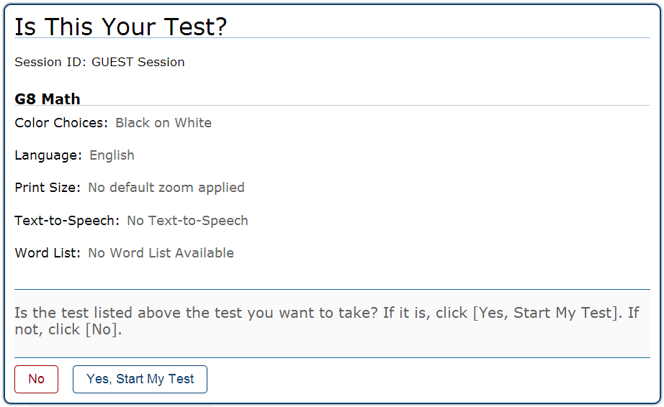
Student View of Testing: Is This Your Test?

Slide 7
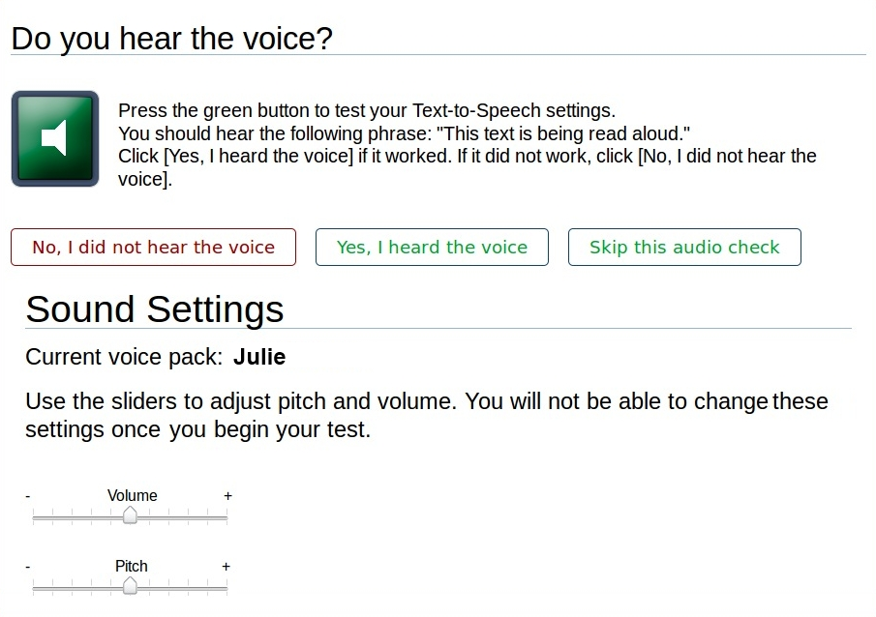
Student View of Testing:
Sound Check

Slide 8
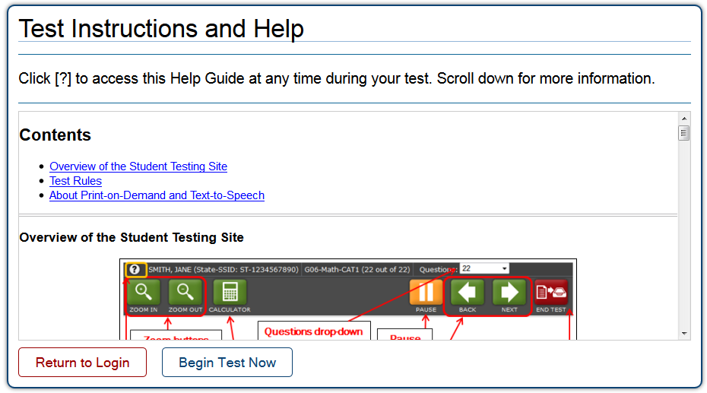
Student View of Testing:
Test Instructions

Slide 9
Universal Tools
All students have the ability to:
Highlight text in passages and test questions
Zoom in and out of test pages (affects all item content)
Mark specific items for review
Strikethrough (cross out answer options)
Use the Notepad or Calculator (depending on the test)
Use the [Expand] button to display a reading passage or a science simulation

Slide 10
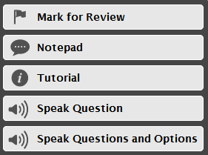
Context Menus
Context Menu for Questions
Context Menu for
Answer Options

Slide 11
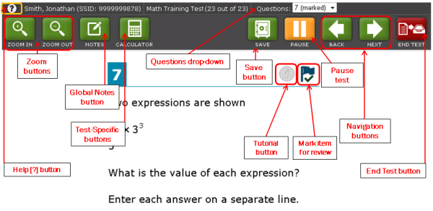
Proceeding Through the Test
To answer multiple-choice items, students must select the desired answer option or select the circle with A, B, C, or D.
To answer machine-scored constructed-response items, students need to carefully follow the instructions given for each question.

Slide 12
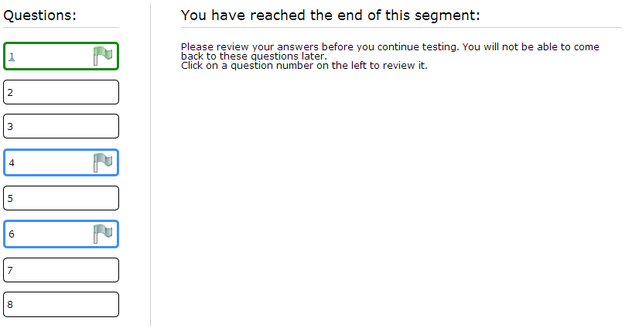
Reviewing Items

Slide 13
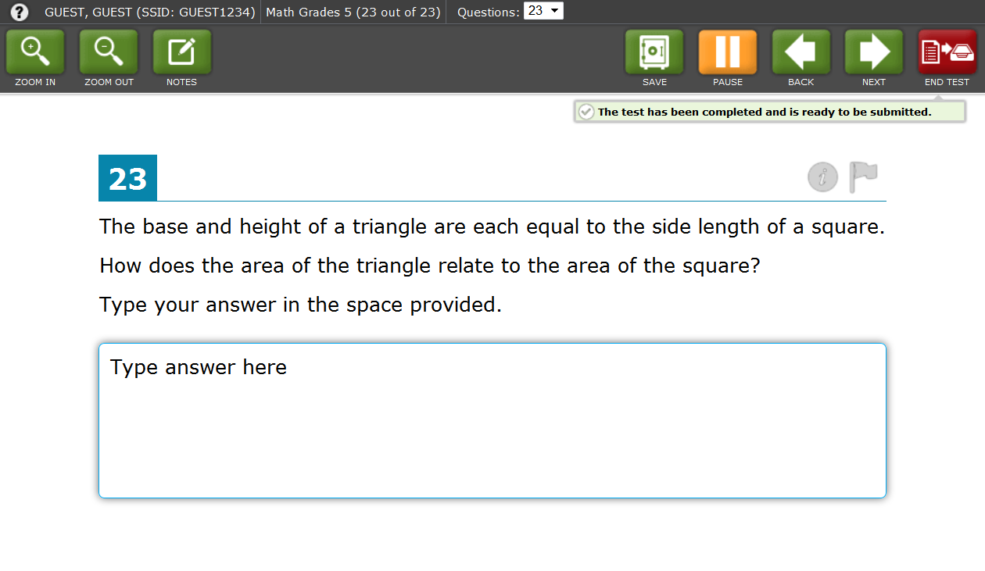
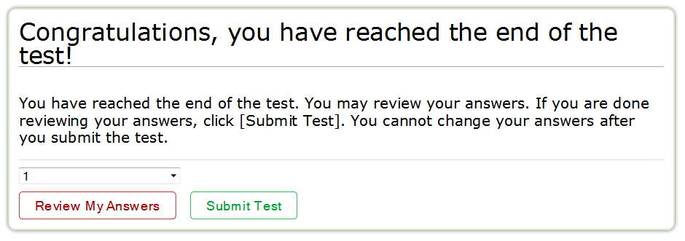
Ending the Test

